Slide 1
SCIENCE PROJECT
CONTA
Data ANALYSIS
DATA
WIN PREDICTION ANALYTICS
BY :-HIMANSHI JAIN

Slide 2
ABSTRACT
In this project, we will analyze and predict the win possibilities of deals for an IT consulting company and see how the possibility of winning a deal is impacted by other variables.
This will enable the IT consulting company to manage the effort required to win a deal to meet the growth targets.

Slide 3
OVERVIEW OF THE PROBLEM
Data ANALYSIS
Data related to the projects/deals won or lost.
Data contains the project category, price and sector from 2011 to 2018 .
Based on the data available build a model to predict the bidding outcome. This will help the organization decide whether the bid manager and his team should invest their effort working for the win.
By predicting the probability of winning a deal, the engagement teams can prioritize the pipeline of opportunities to staff the most attractive options first. With the probability of winning known in advance, deal engagement manager can ensure that for the most profitable deals there are resources available.

Slide 4
SYNOPSIS
In this project, based on the data provided by organization we will try to find meaningful insights and try to understand the current system.
2. Based on the understanding, we will try to create a model which will predict the win percentage for the future outcomes.
3. We can use this model in the CRM system of the organization such as Lead Squared, Sales force and try to create reports for analysis.
4. This will also help us in:-
Sales Management
Lead Cycle
Funnel Building

Slide 5
Problem statement
Data ANALYSIS
OBJECTIVE 1 :-
Recommending top 5 combination of SBU Head-Bid Manager.
OBJECTIVE 2 :-
Build a ML model to predict the probability of win/loss for bidding activities for a potential client.

Slide 6
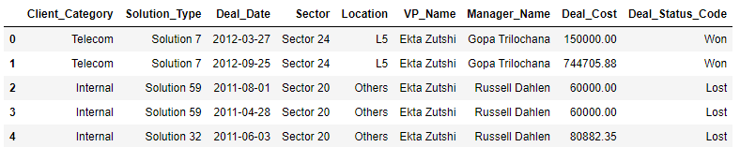
Dataset
Data ANALYSIS
The original dataset contains 10061 observations and 9 variables.
Here is the head of the dataset :-

Slide 7
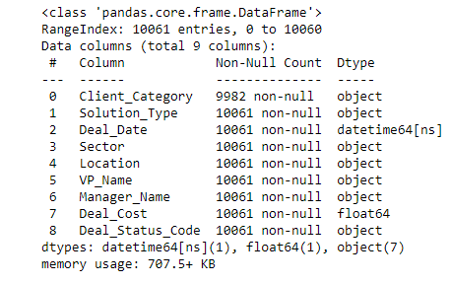
Information of dataset :
Data ANALYSIS
Client Category - Industry in which the client works
Solution Type - The solution group the client requires.
Deal Date - The date the opportunity was created .
Sector - The sector for which the solution is to be provided .
Location - Client location.
VP Name - Sr. Manager or VP who is dealing with the client .
Manager Name - Manager of the team working on the project .
Deal Cost - The initial cost of the deal .
Deal Status Code - Final status of the deal(won/lost) .
Deal Cost The initial cost of the deal Deal Status Code Final status of the deal(won/lost)

Slide 8
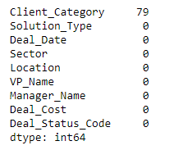
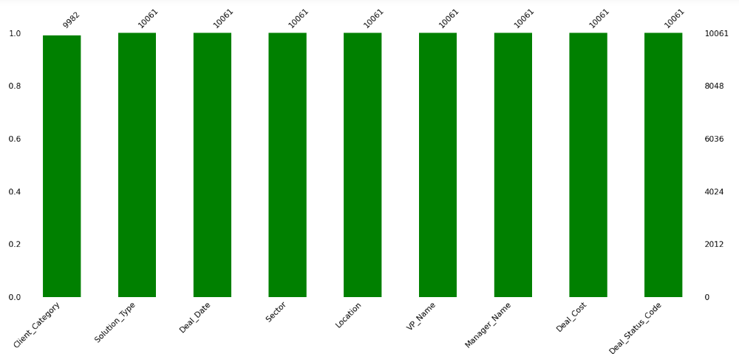
TREATMENT OF MISSING VALUES IN CLIENT CATEGORY
Data ANALYSIS
We have 79 missing values in client category column.

Slide 9
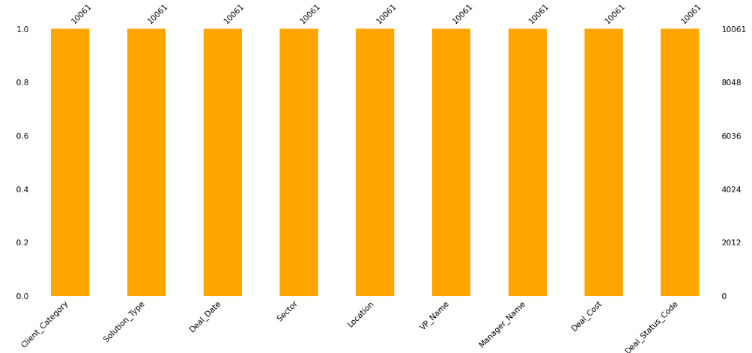
Data ANALYSIS
AFTER MISSING VALUES TREATEMENT IN CLIENT CATEGORY.

Slide 10
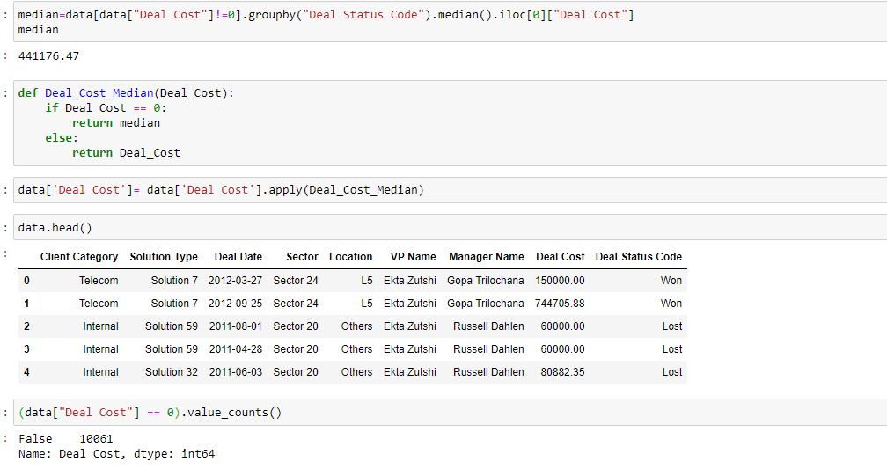
REPLACING ZERO VALUE IN DEAL COST WITH MEDIAN OF DEAL COST

Slide 11
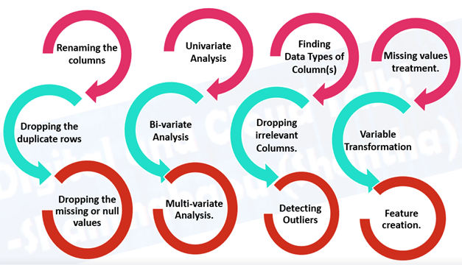
Exploratory data analysis
Data ANALYSIS
Exploratory Data Analysis (EDA) is an approach to analyze the
data using visual techniques.
Steps involved in EDA are as follows :-

Slide 12
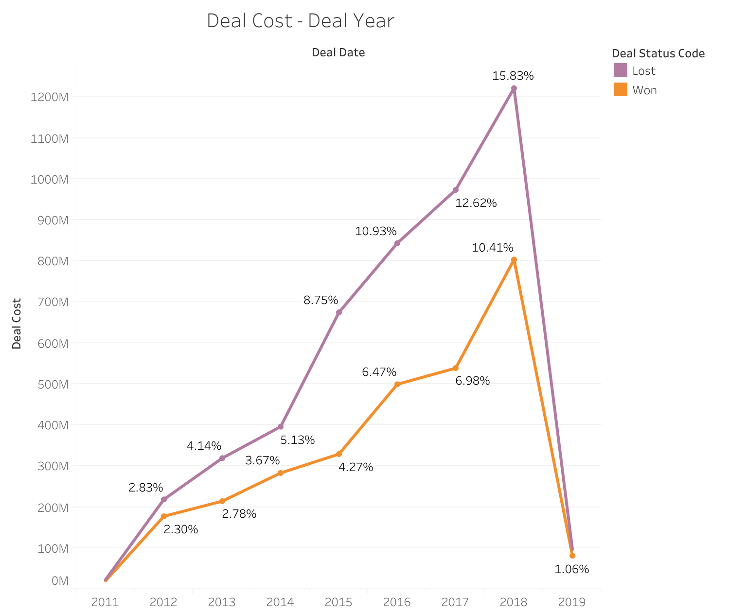
1. Deal cost v/s deal date
Data ANALYSIS

Slide 13
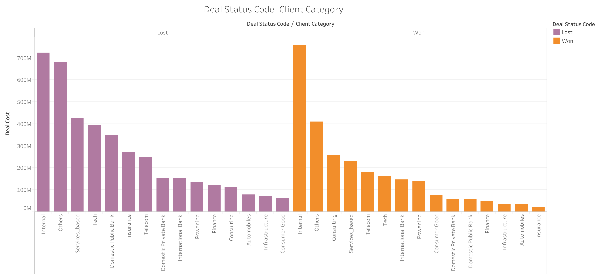
2. Deal status code v/s client category
Data ANALYSIS
MERCURY
70%
Mercury is the closest planet to the Sun
VENUS
30%
Venus is the second planet from the Sun

Slide 14
DESCRIPTION OF PREVIOUS PLOT
Data ANALYSIS
From the previous plot , we understand that the top 5 client categories that :-
A. Lost deals:-
Internal
Others
Services _ based
Tech
Domestic Public Bank
B. Won deals :-
Internal
Others
Consulting
Services _ based
Telecom

Slide 15
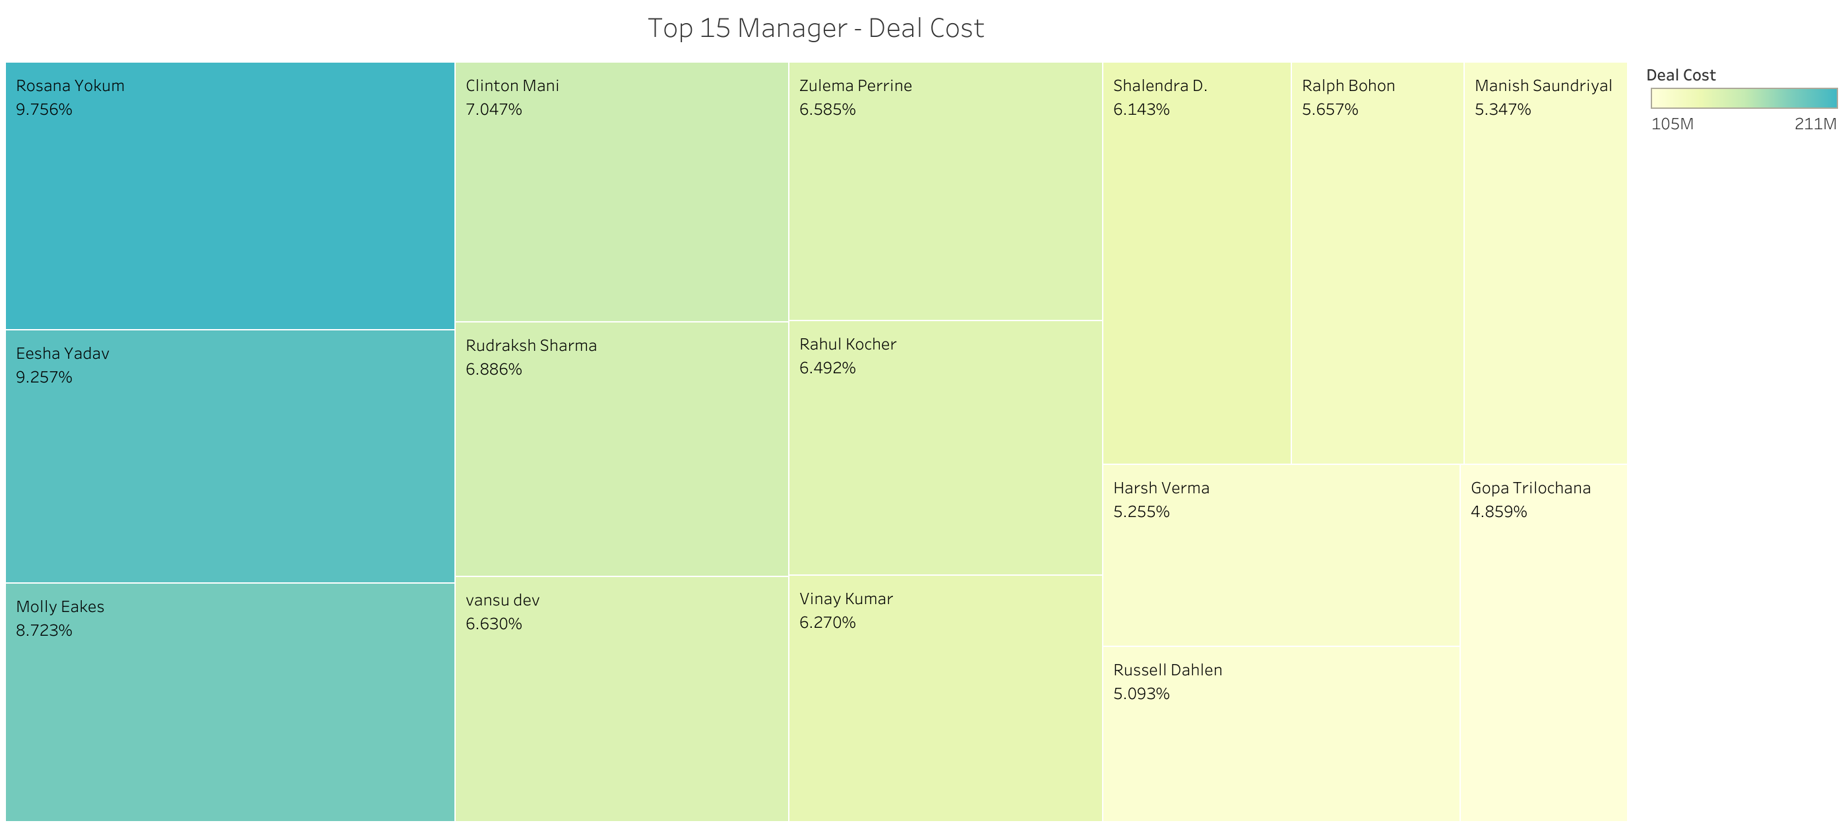
3. Deal cost v/s manager name
MERCURY
VENUS
Data ANALYSIS
TOP 3 MANAGERS HERE ARE :-
ROSANA YOKUM (9.756%)
EESHA YADAV (9.257%)
MOLLY EAKES (8.723%)
It’s the closest planet to the Sun and the smallest in the Solar System

Slide 16
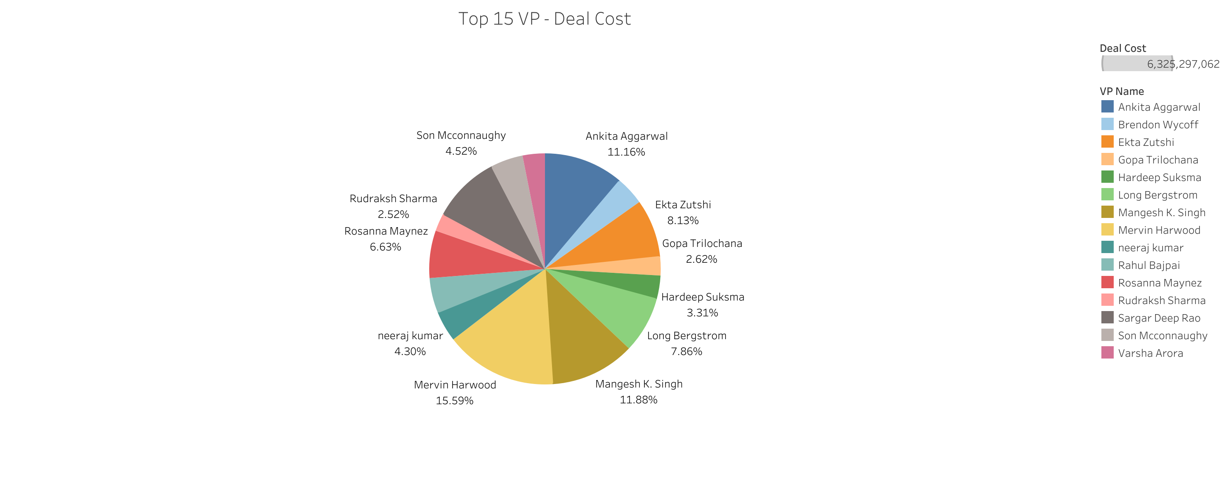
4. Deal cost v/s vp name
DESCRIPTIVE
PREDICTIVE
DIAGNOSTIC
PRESCRIPTIVE
Data ANALYSIS
Venus is the second planet from the Sun
Despite being red, Mars is actually a cold place
It’s the closest planet to the Sun and the smallest
It’s composed of hydrogen and helium

Slide 17
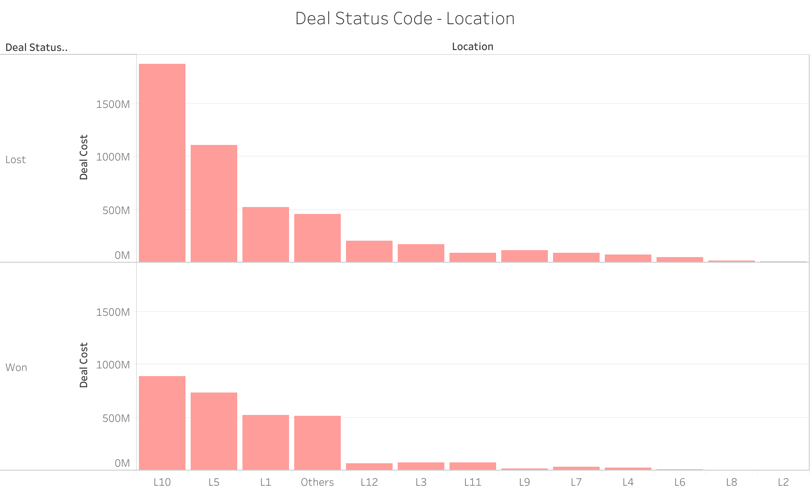
5 .DEAL STATUS CODE V/S LOCATION
MERCURY
VENUS
MARS
Data ANALYSIS
Venus has a beautiful name and is the second planet from the Sun
Despite being red, Mars is actually a cold place. It’s full of iron oxide dust

Slide 18
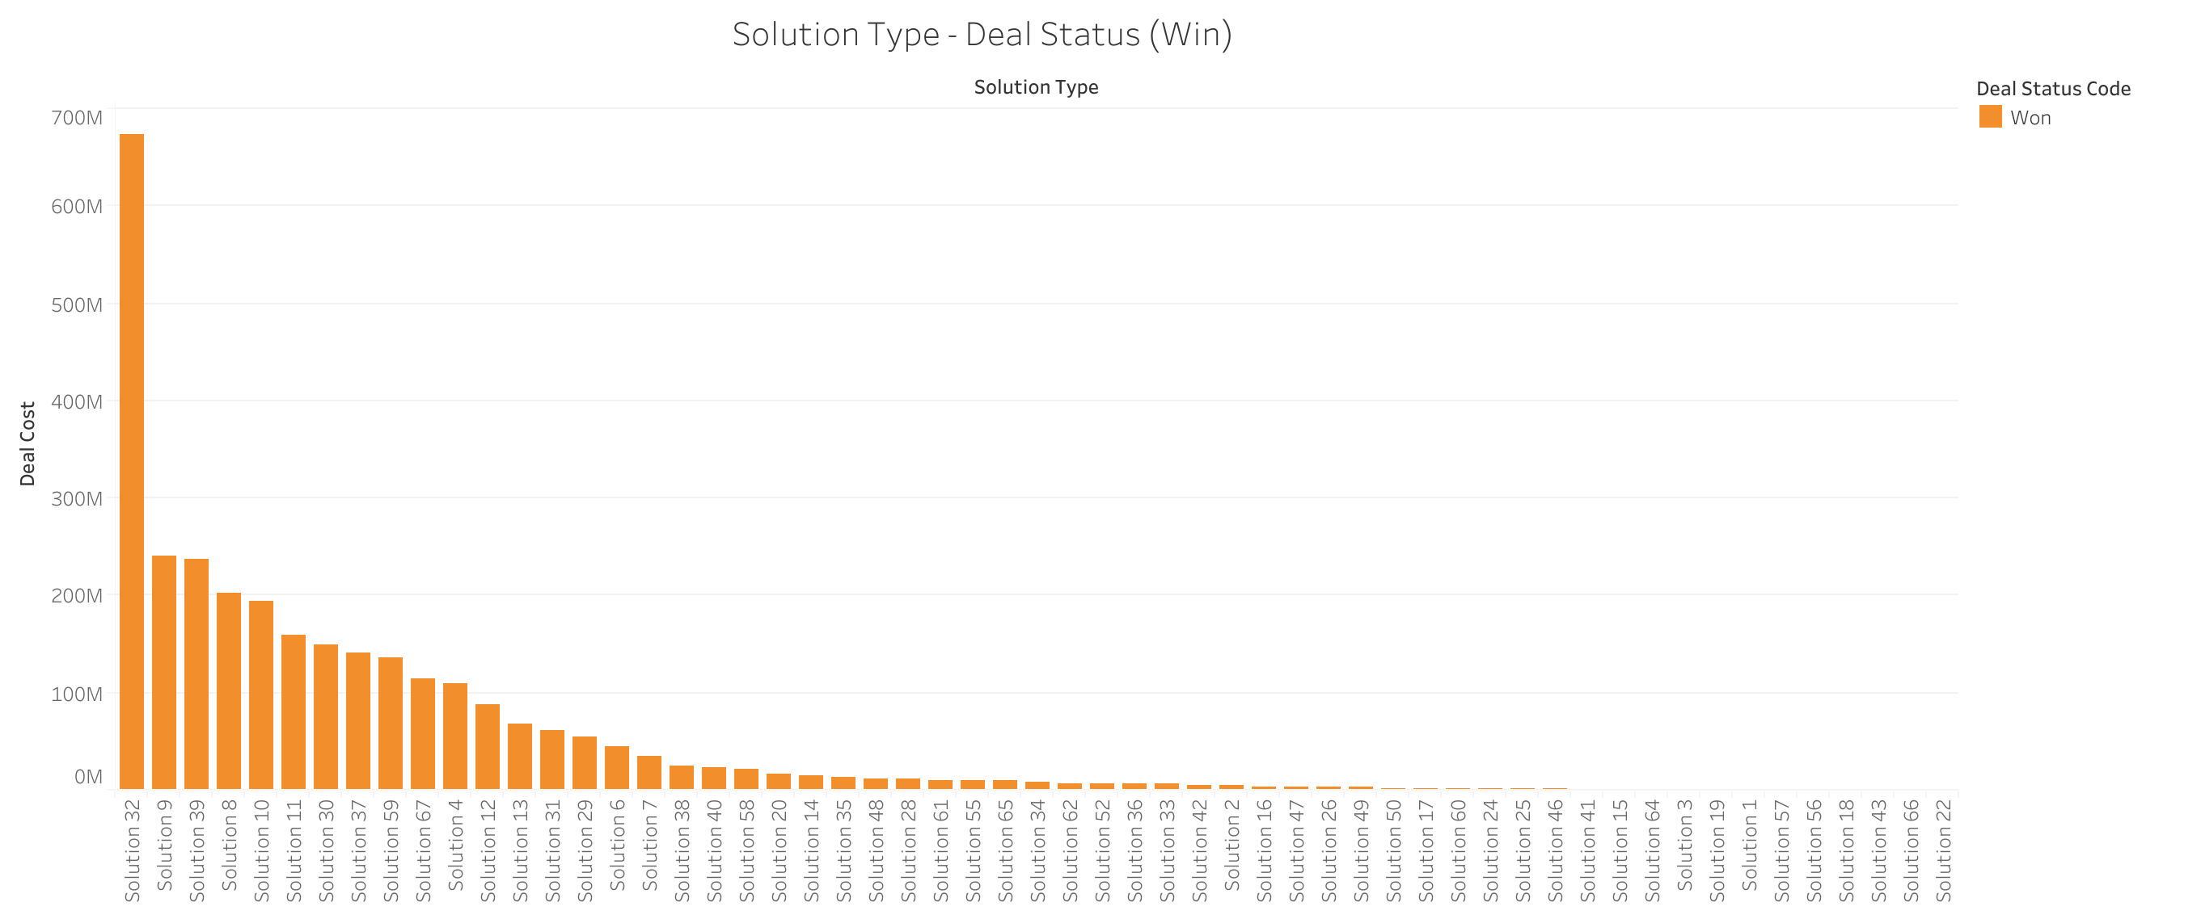
6. DEAL STATUS CODE ( WIN ) V/S SOLUTION TYPE

Slide 19
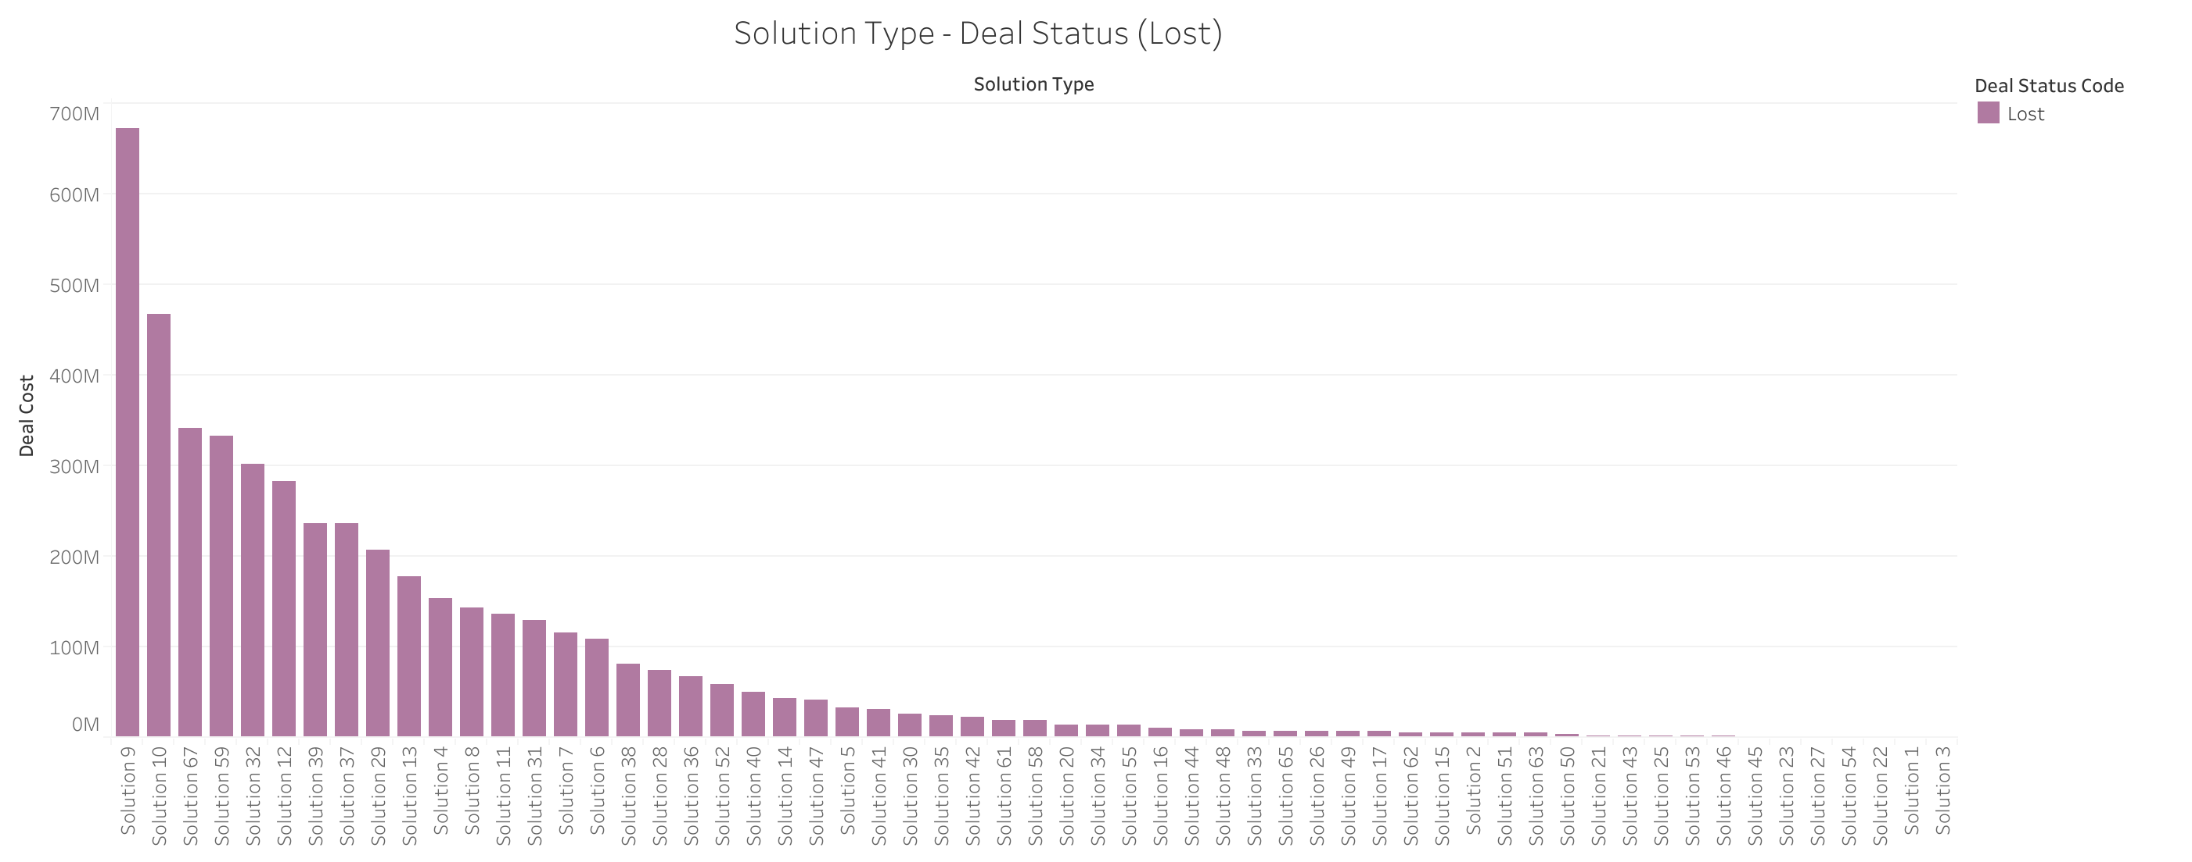
7. DEAL STATUS CODE ( LOSS ) V/S SOLUTION TYPE
Data ANALYSIS
120,
Big numbers catch your audience’s attention

Slide 20

Data ANALYSIS
DESCRIPTION OF DEAL STATUS CODE V/S SOLUTION TYPE
Solution Type :- It is the solution group that the client requires .
A. From plot 6, we understand that top 3 solution type that a client requires to win a deal are as follows :-
i. Solution 32
ii. Solution 9
iii. Solution 39
B. From plot 7, we understand that top 3 solution type that a client requires to loss a deal are as follows :-
i. Solution 9
ii. Solution 10
iii. Solution 67

Slide 21
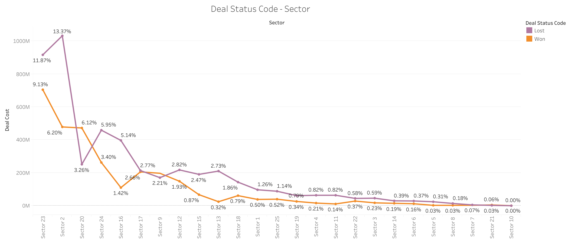

8.DEAL STATUS CODE V/S SECTOR
Data ANALYSIS
Do you know what helps you make your point clear? Lists like this one:
They’re simple
You can organize your ideas clearly
You’ll never forget to buy milk!
And the most important thing: the audience won’t miss the point of your presentation

Slide 22
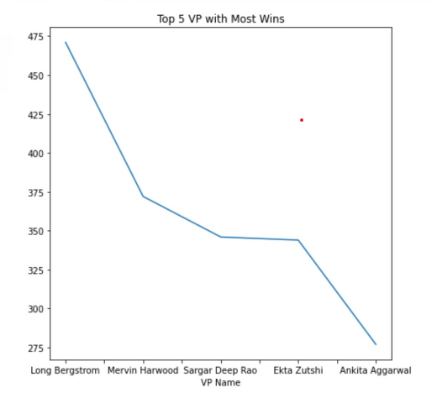
9. TOP 5 VP NAME V/S DEAL STATUS CODE ( WIN )
Data ANALYSIS
NEPTUNE
It’s the farthest planet from the Sun
MARS
Mars is actually a very cold place

Slide 23
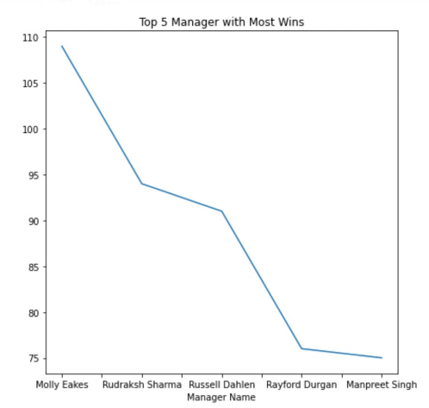
10. TOP 5 MANAGER NAME V/S DEAL STATUS CODE (WIN )
Data ANALYSIS

Slide 24
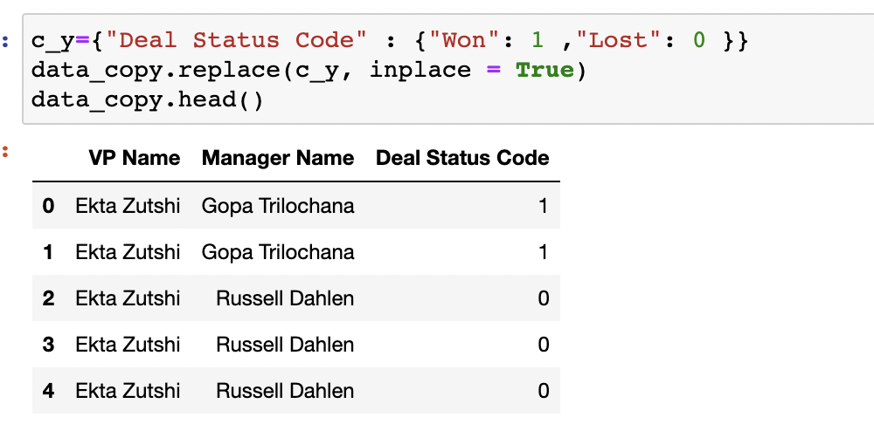
OBJECTIVE 1 : Recommending top 5 combination of SBU Head-Bid Manager.
Data ANALYSIS
Firstly , we change the deal status code into binary values :-

Slide 25
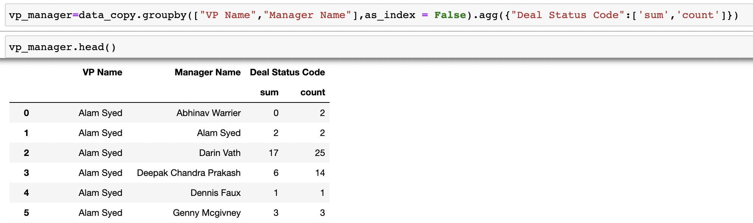
Data ANALYSIS
Then in the second step we use Group By and Aggregate functions to calculate sum and count of deal status code as per VP name and Manager name

Slide 26
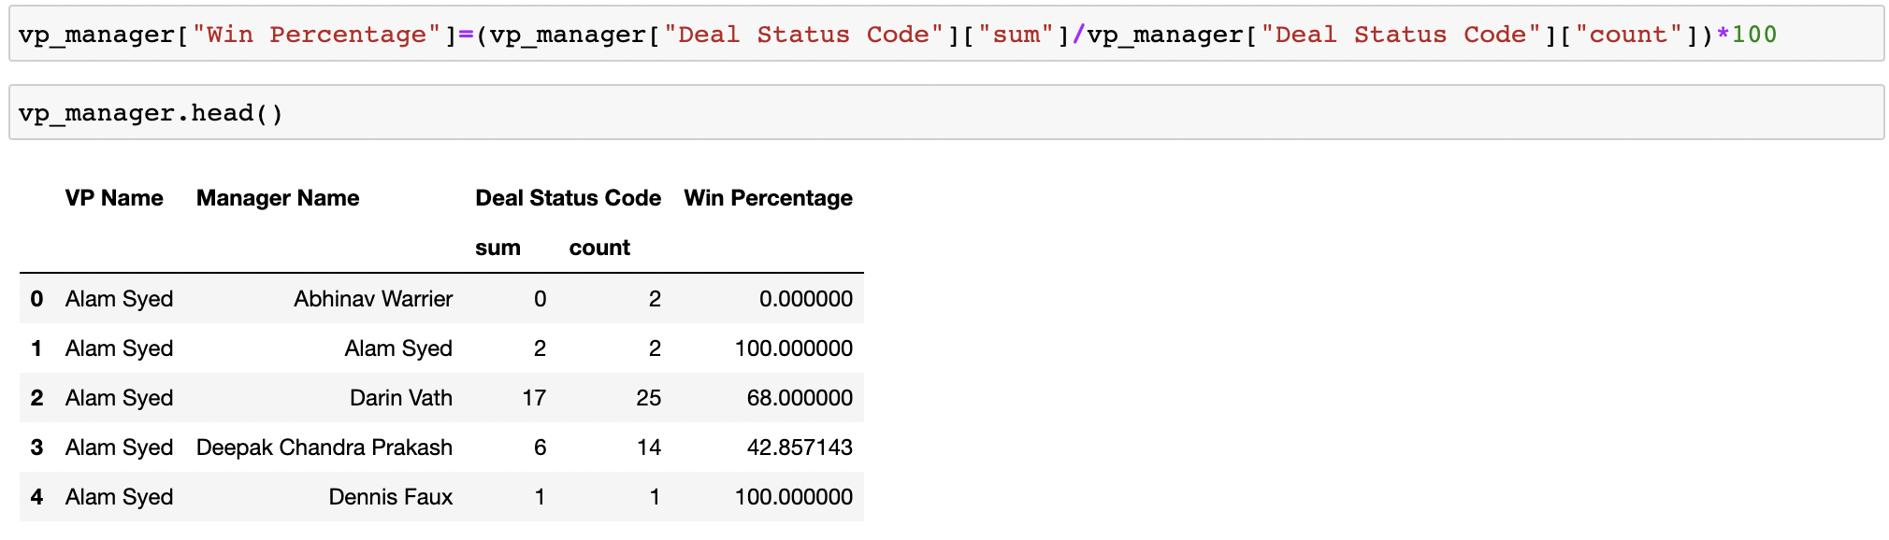
After obtaining sum and count, we calculate Win percentage for every manager

Slide 27
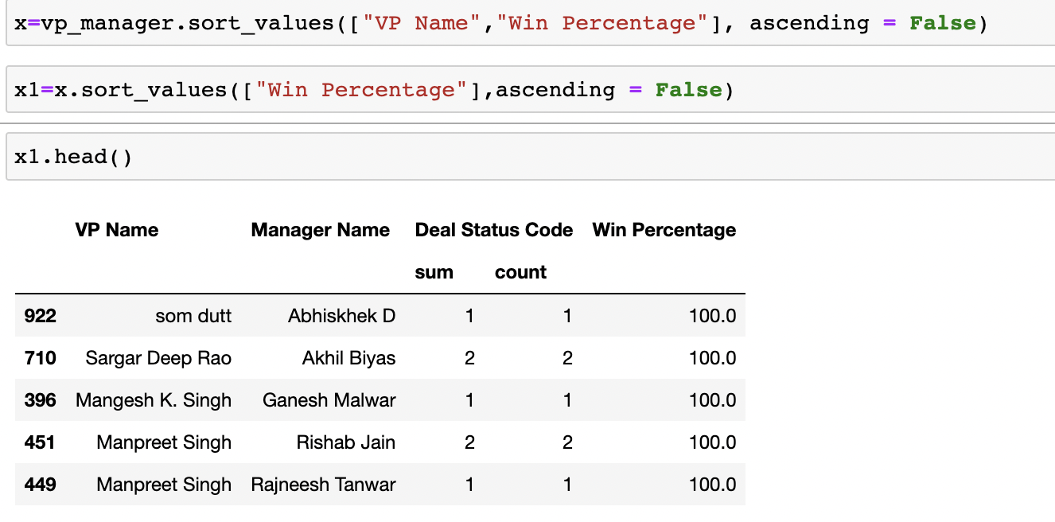
Now We sort the values as per vp name and win percentage and obtain the output in Multi index column
Data ANALYSIS

Slide 28
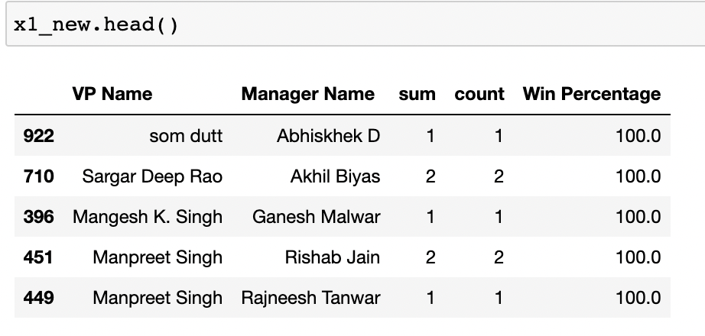
Now we convert MULTI INDEX COLUMN INTO NEW DATA FRAME
Data ANALYSIS

Slide 29
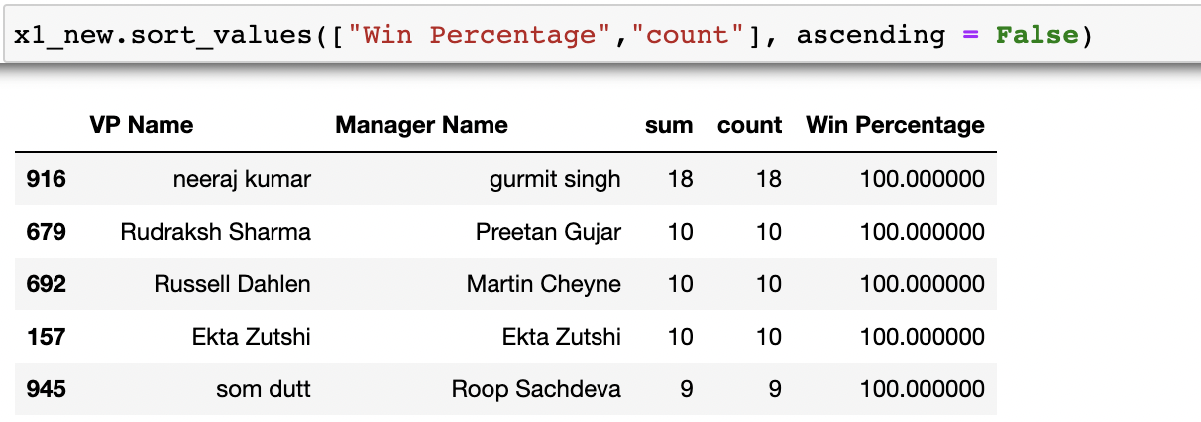
THEN FINALLY WE GET OUR DESIRED OUTPUT OF THE OBJECTIVE 1 THAT IS top 5 combination of SBU Head-Bid Manager
Mercury is the closest planet to the Sun
It’s the farthest planet from the Sun
VENUS
04
03
JUPITER
Venus is the second planet from the Sun
Jupiter is the biggest planet of them all
MARS
05
06
SATURN
Despite being red, Mars is a cold place
It’s composed of hydrogen and helium

Slide 30
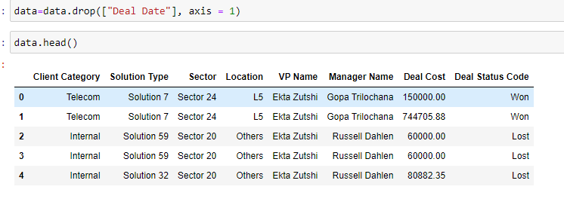
OBJECTIVE 2 : Build a ML model to predict the probability of win/loss for bidding activities for a potential client
Data ANALYSIS
WE DROP DEAL DATE FROM THE DATASET.

Slide 31
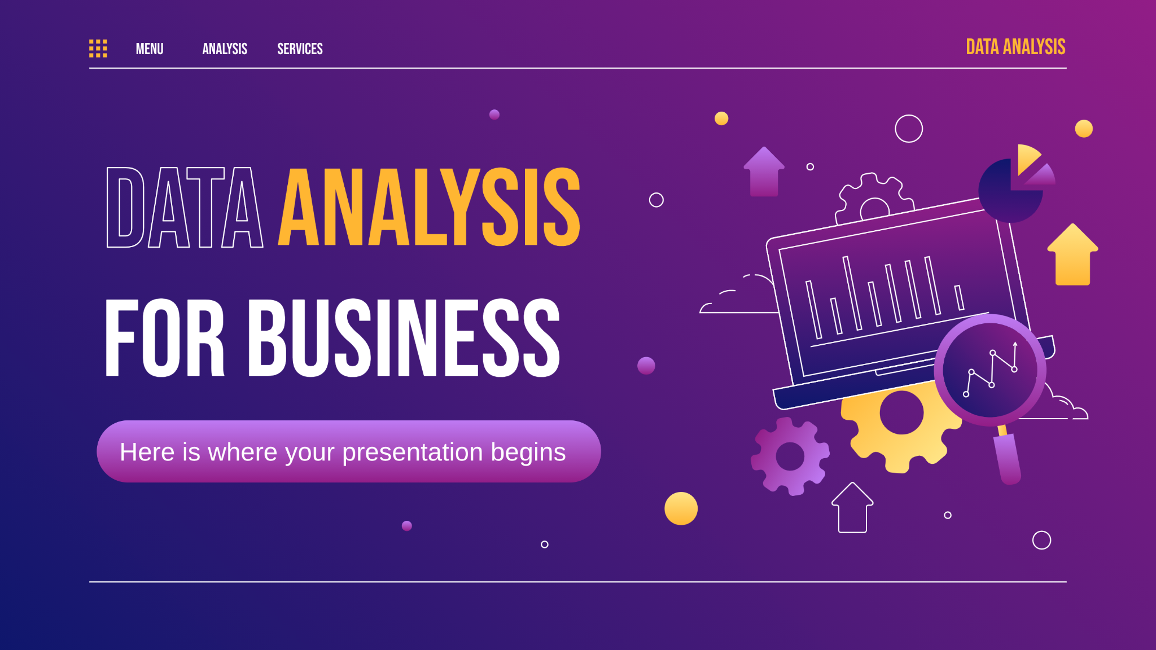
... to check correlation we use pearson correlation
Data ANALYSIS
WHAT IS PEARSON CORRELATION ?
It is the ratio between the covariance of two variables and the product of their standard deviations; thus, it is essentially a normalized measurement of the covariance, such that the result always has a value between −1 and 1.

Slide 32
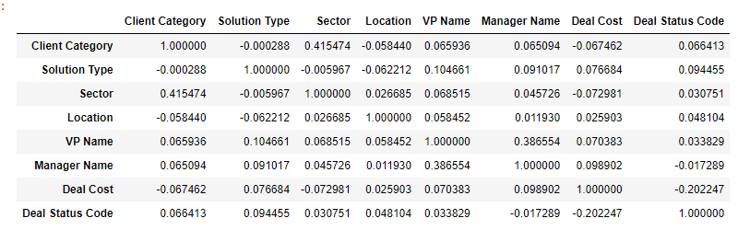
CHECKING CORRELATION
Data ANALYSIS

Slide 33
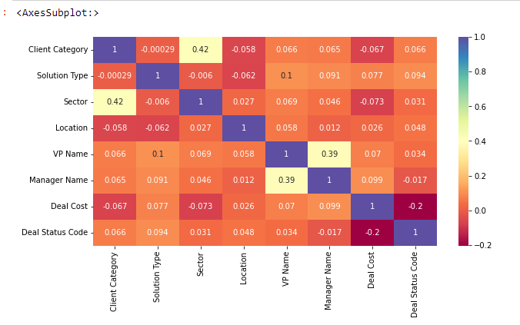
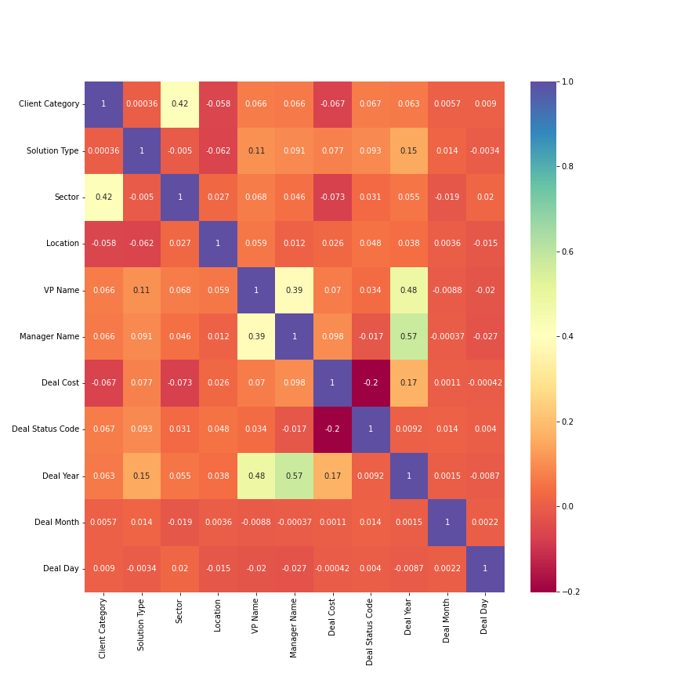
HEAT MAP FOR CORRELATION
Data ANALYSIS

Slide 34
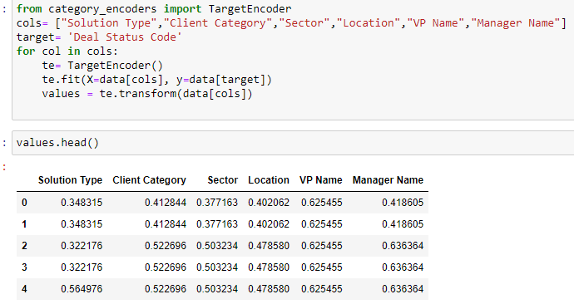
Target encoding
It is the process of replacing a categorical value with the mean of the target
variable.

Slide 35
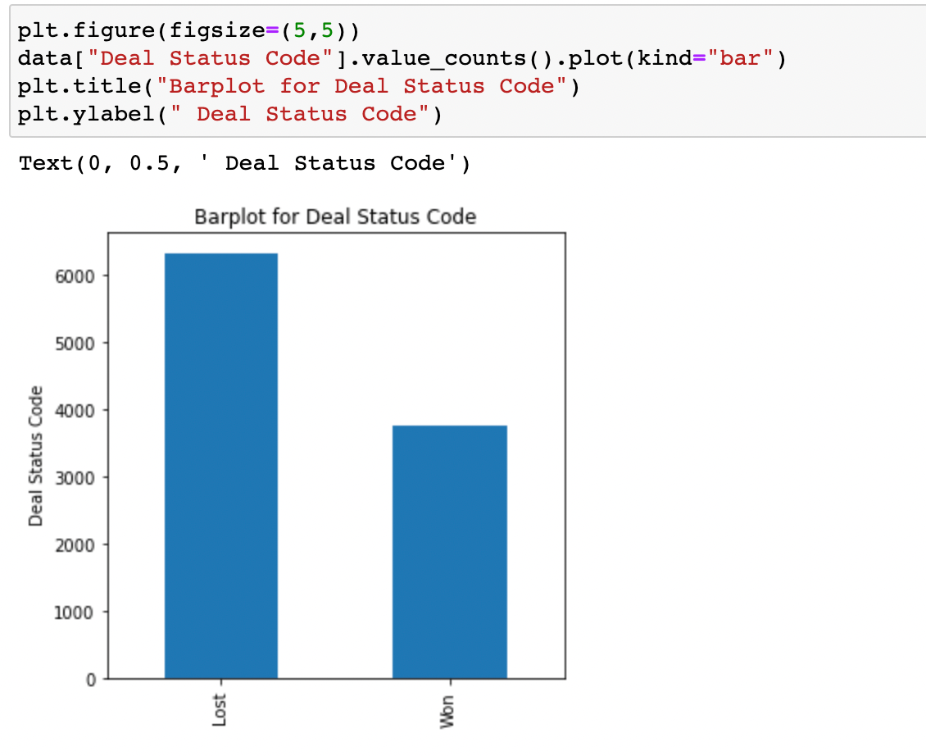
From this bar plot we conclude that there are approximately 6000 lost deals and 3500 win deals present in the given dataset.

Slide 36
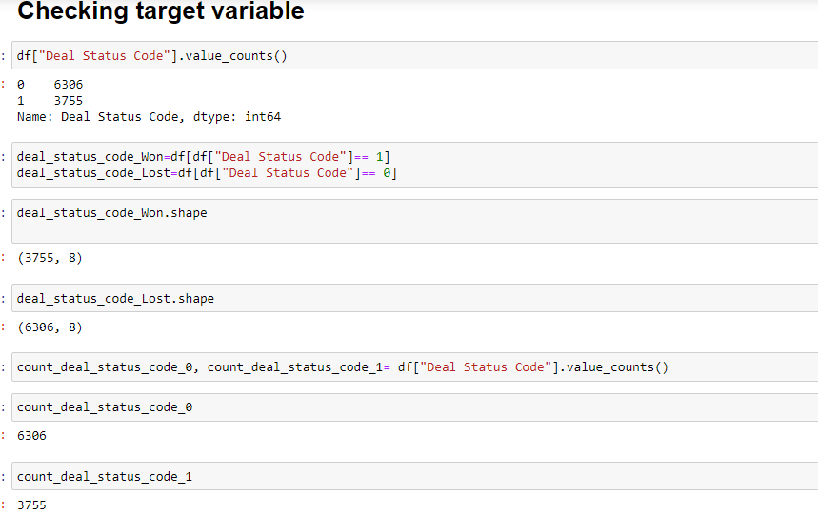
Now we check imbalanced data in given dataset

Slide 37
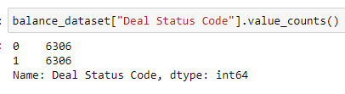
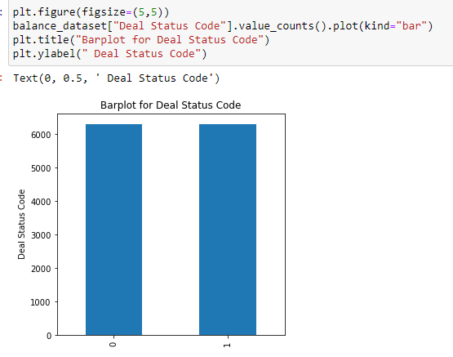
Next step is over sampling to balance the target variable

Slide 38
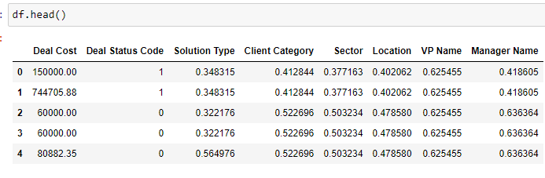
This is the final dataset that we are going to use to create the models .

Slide 39
Model selection criteria
This is a logistic regression problem so , we can use decision tree , random forest , KNN and XGBoost for this dataset.
Ensemble methods like Random Forest, Decision Tree, XGboost algorithms have shown very good results when we talk about classification. These algorithms give high accuracy at fast speed.
Because this dataset contains categorical data that’s why we used target encoding instead of label encoding or one hot encoding .
Also for hyperparameter tuning we use Random search CV because it is more faster and efficient than Grid Search .

Slide 40
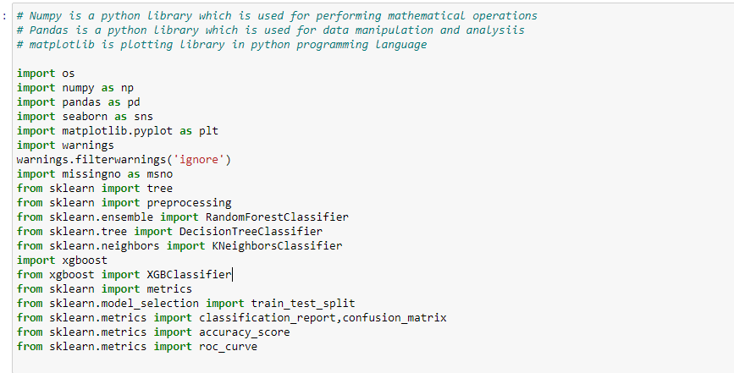
Data ANALYSIS
LIBRARIES USED DURING MODEL BUILDING ARE AS FOLLOWS :-

Slide 41
Data ANALYSIS
INDEPENDENT AND DEPENDENT VARIABLE IN THE DATASET .
Dependent variable in the dataset is “ Deal Status Code”.
Independent variables in the dataset are :- 1.Client Category
2.Manager Name
3.VP Name
4.Solution Type
5.Sector
6.Location
7.Deal cost

Slide 42
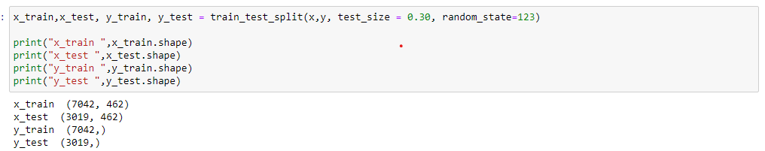
SPLITTING THE DATASET INTO TRAINING AND TESTING
Data ANALYSIS
RANDOM_STATE = It is an integer value which implies the selection of a random combination of train and test .
TEST_SIZE = It is the number that defines the size of the test set.
Here , test_size is 30% and remaining 70% of the data is considered as train_size.

Slide 43
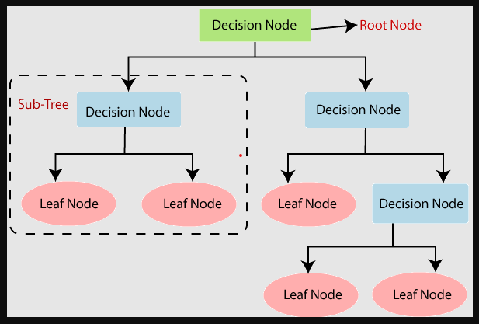
MODEL 1 : DECISION TREE
Data ANALYSIS
Decision Tree is the most powerful and popular tool for classification and regression.
It is a flowchart-like tree structure, where each internal node denotes a test on an attribute, each branch represents an outcome of the test, and each leaf node (terminal node) holds a class label.

Slide 44
CLASSIFICATION REPORT
A classification report is a performance evaluation metric in machine learning. It is used to show the precision, recall, F1 Score, and support of your trained classification model .
PRECISION :- Precision is defined as the ratio of true positives to the sum of true and false positives. Precision = True Positives / (True Positives + False Positives)
RECALL :- Recall is defined as the ratio of true positives to the sum of true positives and false negatives. Recall = True Positives / (True Positives + False Negatives)
F1 SCORE :- The F1 is the weighted harmonic mean of precision and recall. The closer the value of the F1 score is to 1.0, the better the expected performance of the model is.
SUPPORT :- Support is the number of actual occurrences of the class in the dataset. It doesn’t vary between models, it just diagnoses the performance evaluation process.

Slide 45
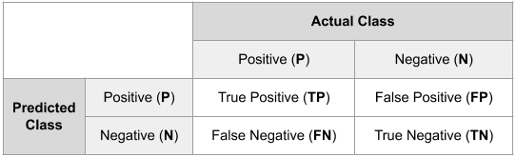
Confusion matrix and accuracy
Confusion matrix is a table that is used in classification problems to assess where errors in the model were made.
Accuracy score is used to measure the model performance in terms of measuring the ratio of sum of true positive and true negatives out of all the predictions made.

Slide 46
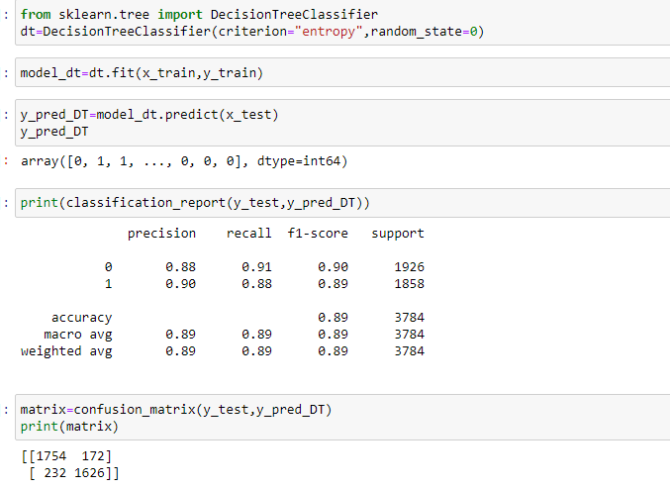
Classification report , accuracy and confusion matrix of decision tree

Slide 47
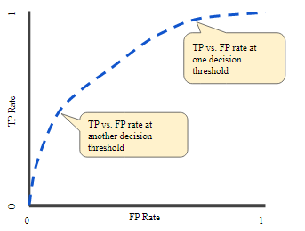
ROC CURVE
An ROC curve (receiver operating characteristic curve) is a graph showing the performance of a classification model at all classification thresholds.

Slide 48
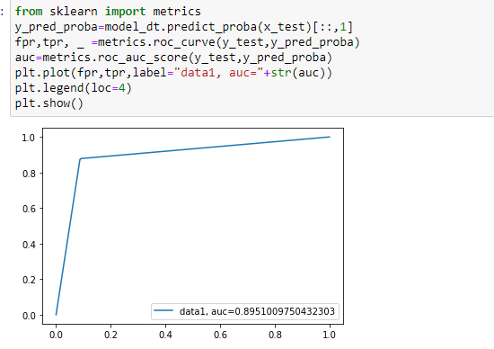
ROC CURVE OF DECISION TREE
“ Area Under the ROC Curve ”
measures the entire two-dimensional area underneath the entire ROC curve from (0,0) to (1,1).
Here, AUC is 0.895.

Slide 49
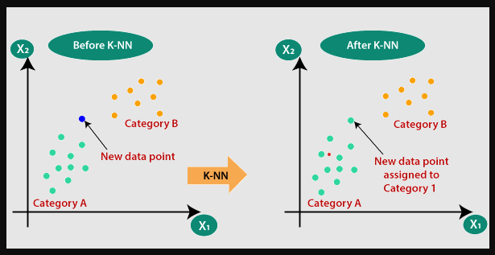
Model 2 : k - nearest neighbour ( knn )
Data ANALYSIS
KNN is a supervised machine learning algorithm . The algorithm can be used to solve both classification and regression problem statements
This algorithm uses 'feature similarity' to predict the values of new data points which further means that the new data point will be assigned a value based on how closely it matches the points in the training set.

Slide 50
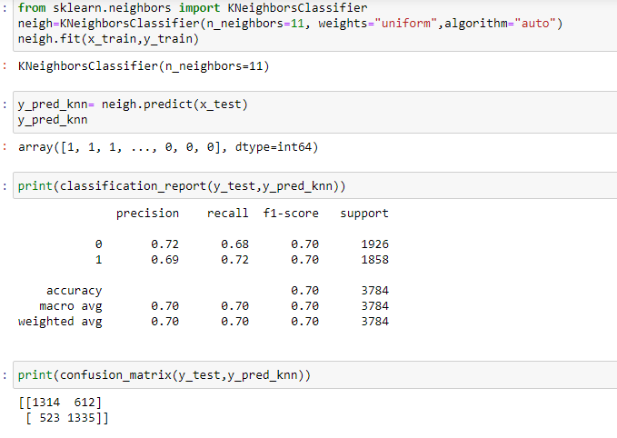
Classification report , accuracy and confusion matrix of knn

Slide 51
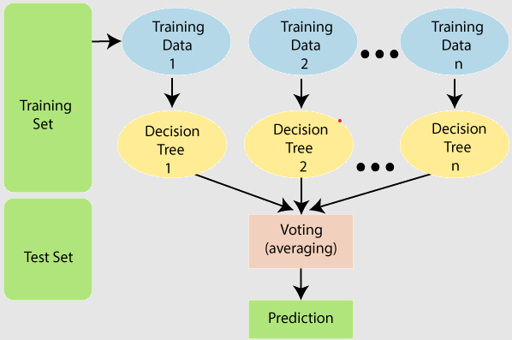
MODEL 3 : RANDOM FOREST
Data ANALYSIS
Random Forest is a supervised machine learning algorithm that grows and combines multiple decision trees to create a “forest.”
The logic behind the Random Forest model is that multiple uncorrelated models (the individual decision trees) perform much better as a group than they do alone.
When using Random Forest for classification, each tree gives a classification or a “vote.” The forest chooses the classification with the majority of the “votes.”
When using Random Forest for regression, the forest picks the average of the outputs of all trees.

Slide 52
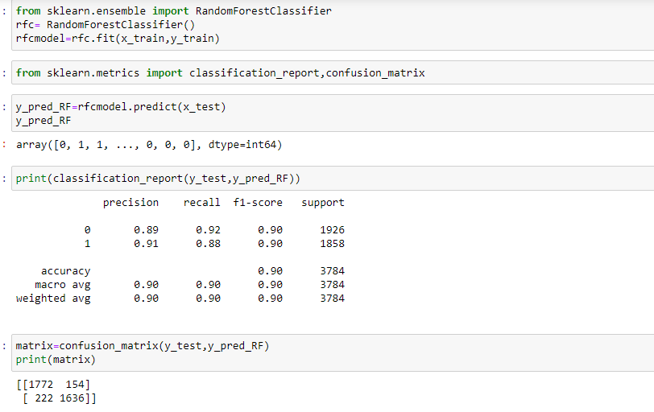
Classification report , accuracy and confusion matrix of random forest

Slide 53
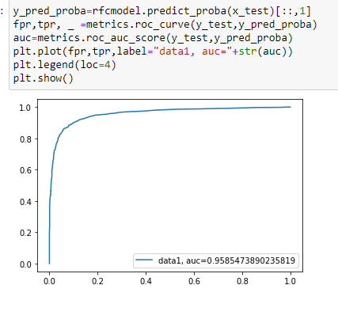
Roc curve of random forest

Slide 54
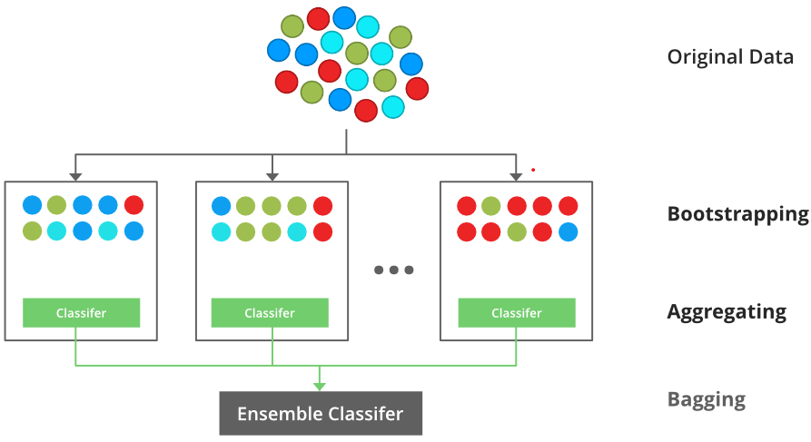
MODEL 4 : XGBOOST
XGBoost is used for supervised learning problems, where we use the training data (with multiple features) to predict a target variable
XGBoost (Extreme Gradient Boosting) belongs to a family of boosting algorithms and uses the gradient boosting (GBM) framework at its core.
It is an optimized distributed gradient boosting library.

Slide 55
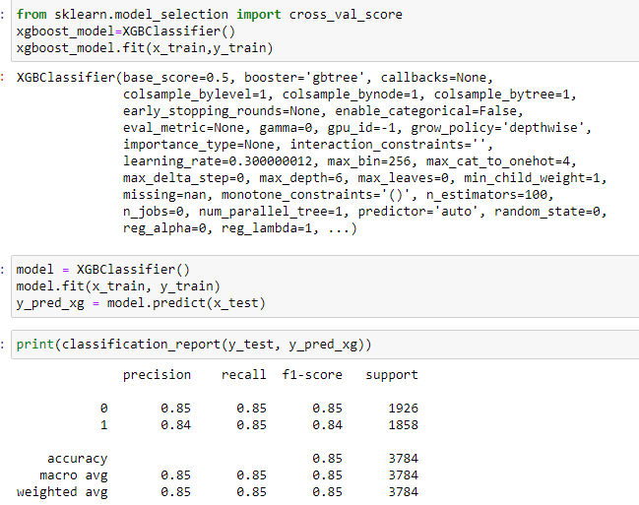
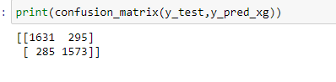
Classification report ,accuracy and confusion matrix of XGBOOST

Slide 56
Hyper parameter tuning
1.Hyper parameter tuning consists of finding a set of optimal hyper parameter
values for a learning algorithm while applying this optimized algorithm to any
data set.
2. Hyper parameter tuning consists of finding a set of optimal hyper parameter values for a learning algorithm while applying this optimized algorithm to any data set. That combination of hyper parameters maximizes the model’s performance, minimizing a predefined loss function to produce better results with fewer errors.
3.A hyper parameter is a parameter whose value is used to control the learning process. By contrast, the values of other parameters (typically node weights) are learned.

Slide 57
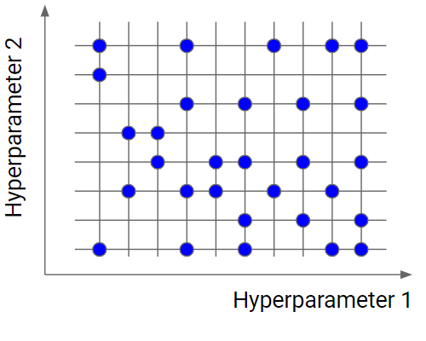
RANDOM SEARCH CV
<> Random search is similar to grid search, but instead of using all the points in the grid, it tests only a randomly selected subset of these points.
<> The smaller the subset the faster but less accurate the optimization. The larger this dataset, the more accurate the optimization.

Slide 58

HYPER PARAMETER TUNING FOR XGBOOST
SETTING UP PARAMETERS AND TRAINING THE MODEL :-

Slide 59

OBTAINING BEST PARAMETERS AND ESTIMATORS :-

Slide 60


Creating the model from the best parameters obtained:-
PREDICTIONS AND
CLASSIFICATION REPORT :-

Slide 61

CONFUSION MATRIX
True Positive Values :- 1758
False Positive (Type 1) :- 168
True Negative Values :- 1678
False Negative (Type 2):- 180

Slide 62

HYPERPARAMETER TUNING FOR RANDOM FOREST
MODEL BUILDING :-
TRAINING THE MODEL AND OBTAINING BEST PARAMETERS :-

Slide 63


Creating model based on hyper parameters obtained from Random Search CV
PREDICTIONS AND CLASSIFICATION REPORT

Slide 64

CONFUSION MATRIX
Confusion Matrix :-
True Positive Values :- 1764
False Positive (Type 1) :- 162
True Negative Values :- 1675
False Negative (Type 2):- 183

Slide 65
CONCLUSION
Out of all models , XGBoost with hyperparameter tuning is the best model. It has least number of false predictions and high accuracy score.
Out of all the VP-Manager combination , Neeraj Kumar and Gurmeet Singh are the consistent pair in the organization winning all 18 deals with 100% win.
Sector 2 and 23 has the highest win percentage for the organization. But the same sectors has highest loss percentage. The overall net score is negative.
We recommend to send Neeraj Kumar and Gurmeet Singh to sector 23 to and Rudraksh Sharma and Preetan Gujar to sector 2.
Mervin Harwood and Ankita Aggarwal both the VP’s have highest number of deal bidding in the organization.
Mervin Harwood has 31% winning ratio out of 1166 deals and Ankita Aggarwal has 24% of winning ratio out of 1143 deals. The conversion ratio of is low.

Slide 66
CONCLUSION
We recommend to restructure the lead flow or churn the existing leads along with new leads to other teams.
Out of all the VP’s, Ekta Zutshi and team has the highest win ratio of 62% out of 550 deals. Along with managing the team, Ekta Zutshi has also closed 10 deals individually with 100% win.
We recommend to increase the lead flow for Ekta Zutshi to obtained maximum efficiency and conversion.
VP Prashant Rawat and Vikram Rawat has a good number in closing with less number of overall deals.

Slide 67
THANK YOU

